Slide 1

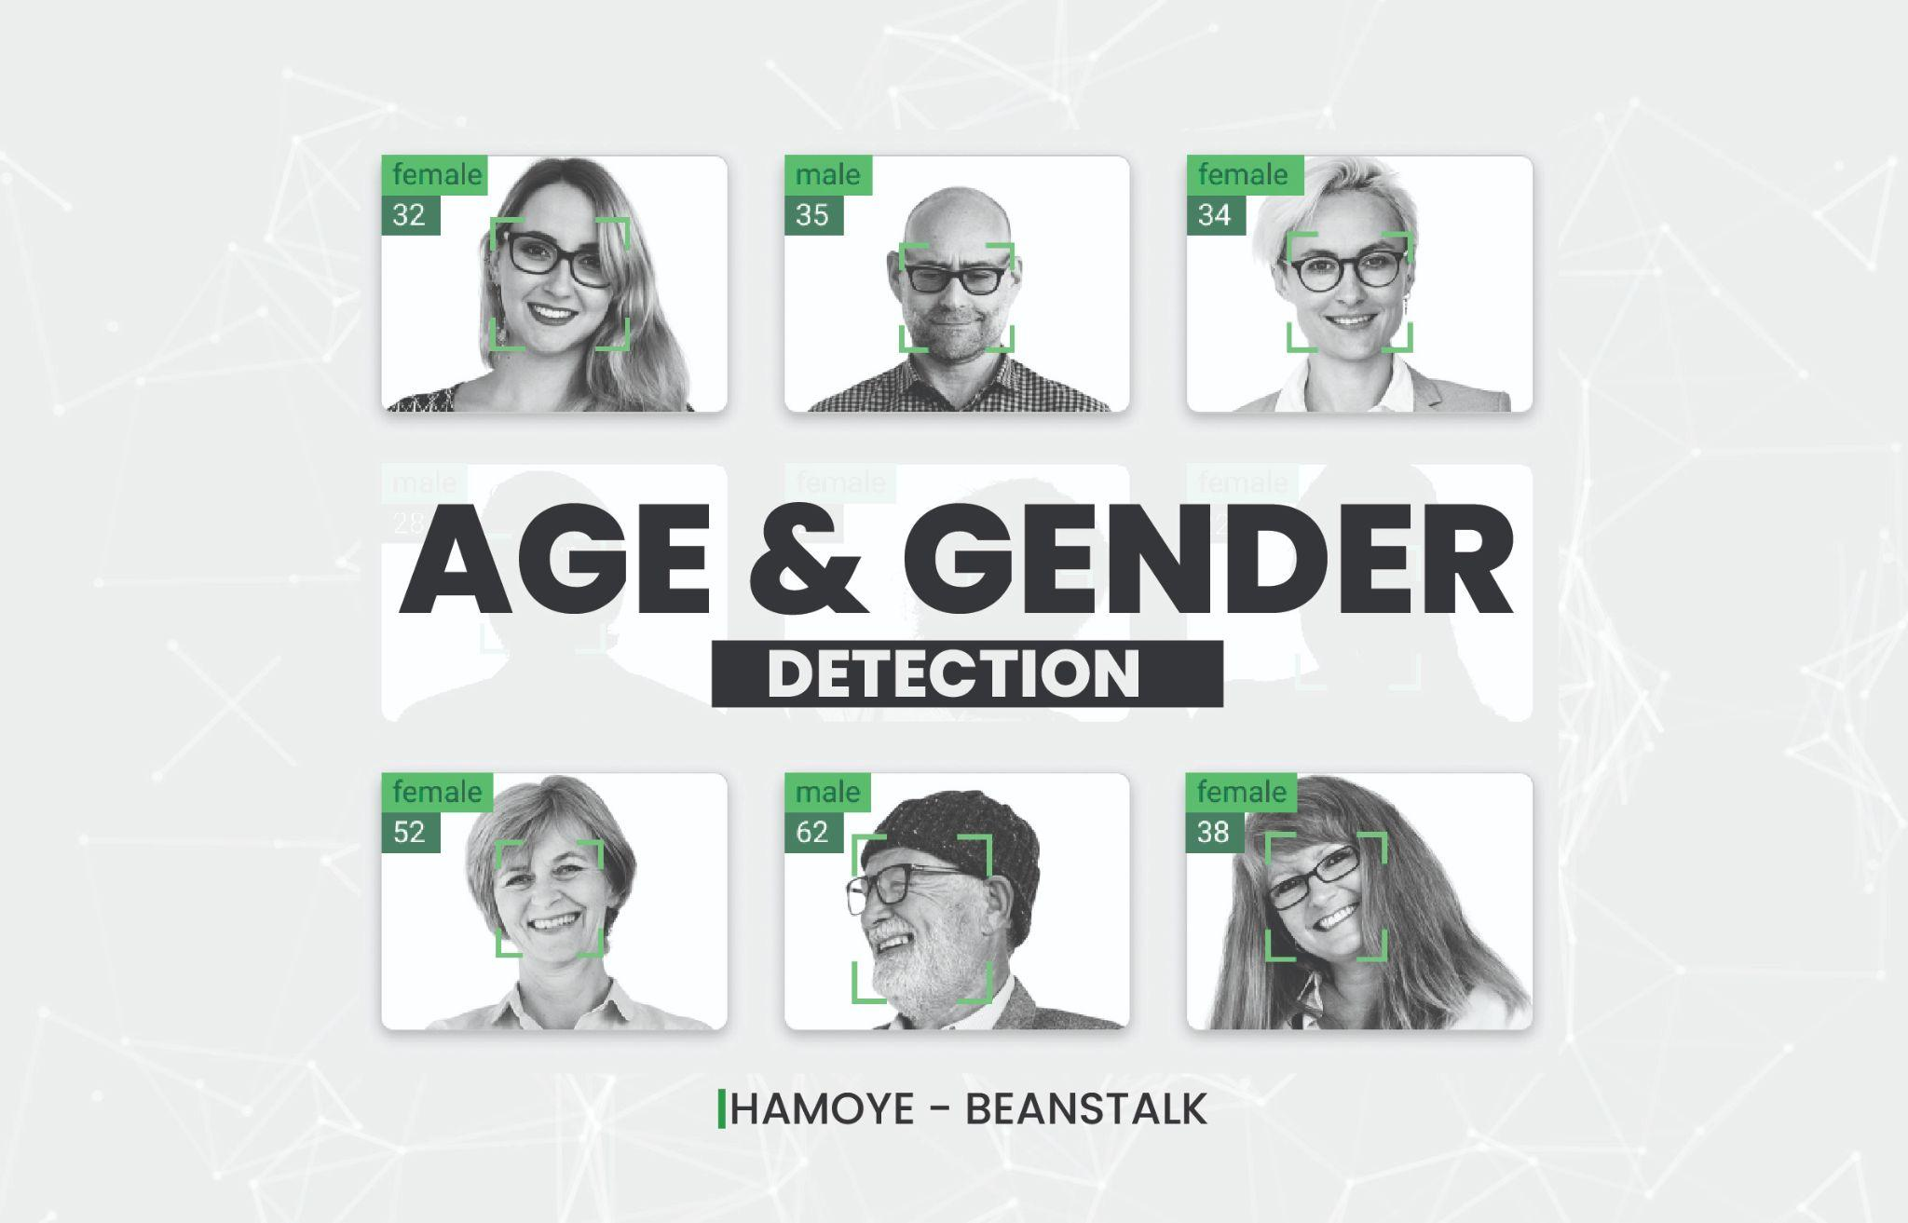

BeanStalk
March 4, 2023

Slide 2

BEANSTALK GROUP
PRESENTERS
TEAM MEMBERS
Ezile Nyangule
Esuola Stephen
Esuola Stephen
Ayoola Damilare
Jacobs Agyei
Zakaria Jnayni
Rahul TG
Ezile Nyangule
Enoch Adetunji
REPRESENTATIVES
Team Lead: Stephen Esuola
Asst. Team Lead: Damilare Ayoola
Query Analyst: Jacobs S. Agyei
BeanStalk

Slide 3
Dataset Description
UTKFace Images
https://www.kaggle.com/datasets/nipunarora8/age-gender-and-ethnicity-face-data-csv)
It has 23,705 observations and 5 features
Features are Age, Ethnicity, Gender, Image Name and Pixels.
BeanStalk

Slide 4
Gain insight on the data
Project Objective
Preprocessing
Feature Engineering
BeanStalk
Modelling, Evaluation and Testing

Slide 5
Methodology
Data Collection and Assessment
Cleaning and Wrangling
Visualization
Features Engineering
Modelling and Evaluation
Testing
BeanStalk

Slide 6
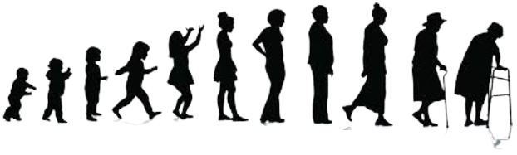
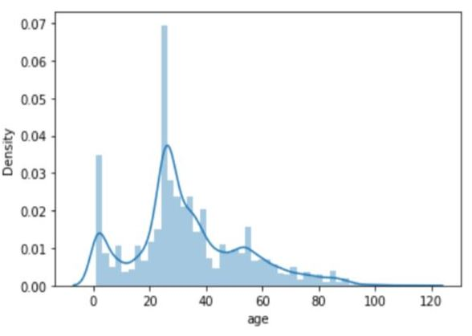
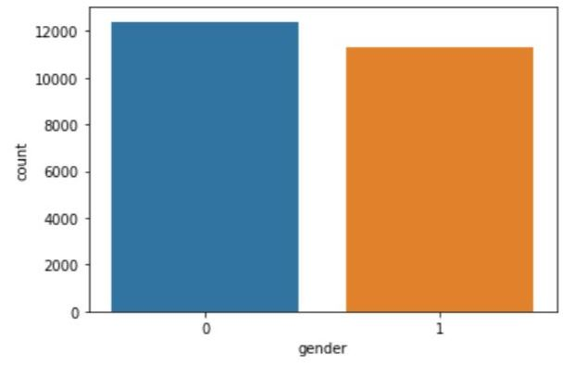
Data Distribution
Age Distribution (1yr – 116yrs)
Gender Class {0:Male, 1:Female}
BeanStalk

Slide 7
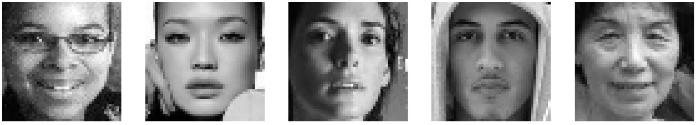
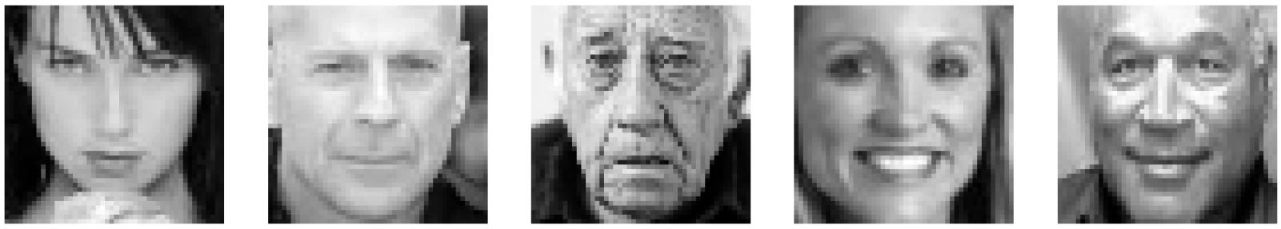
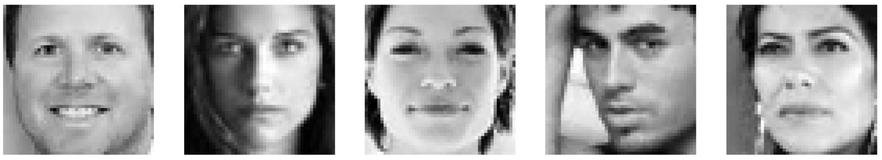
Display of Sample Images
BeanStalk

Slide 8
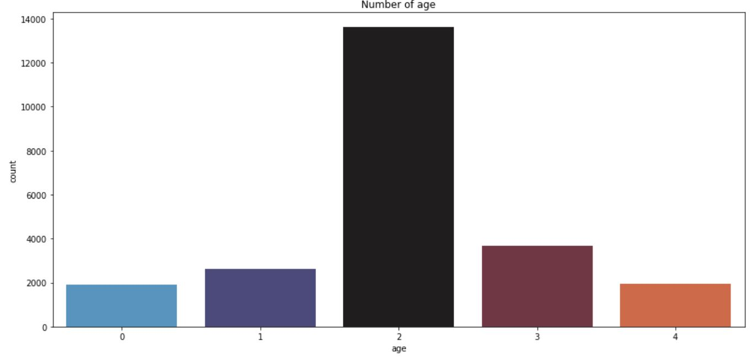
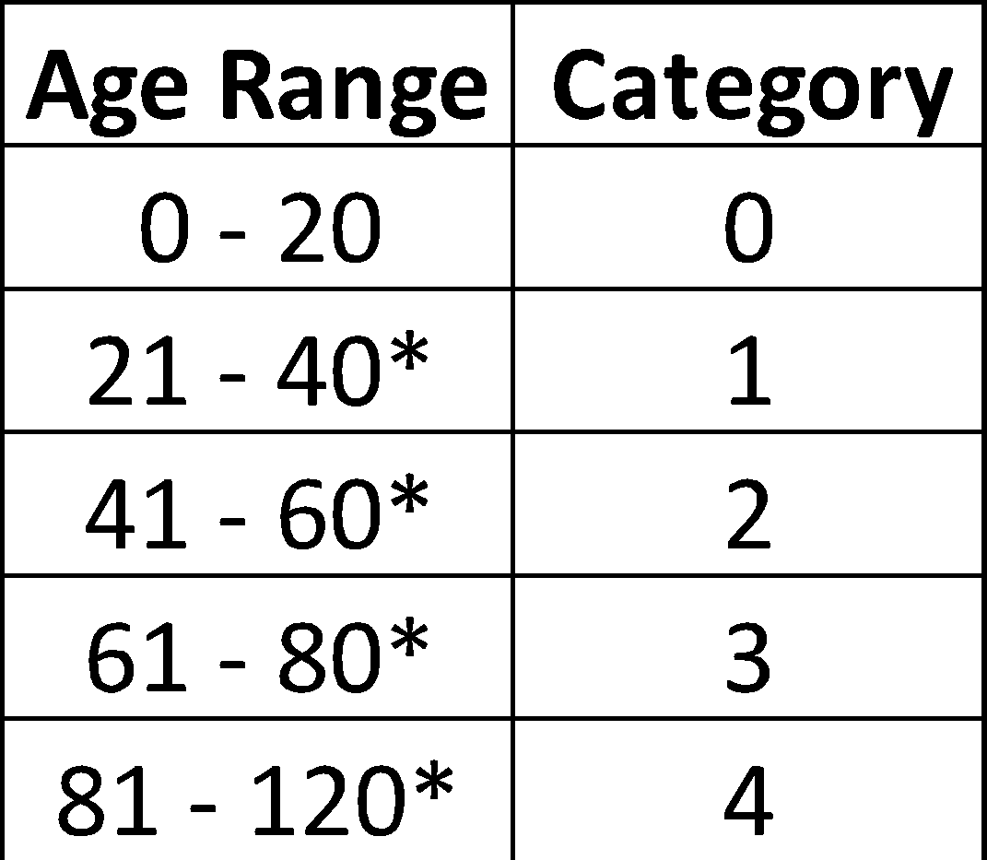
Age Grouping
BeanStalk

Slide 9
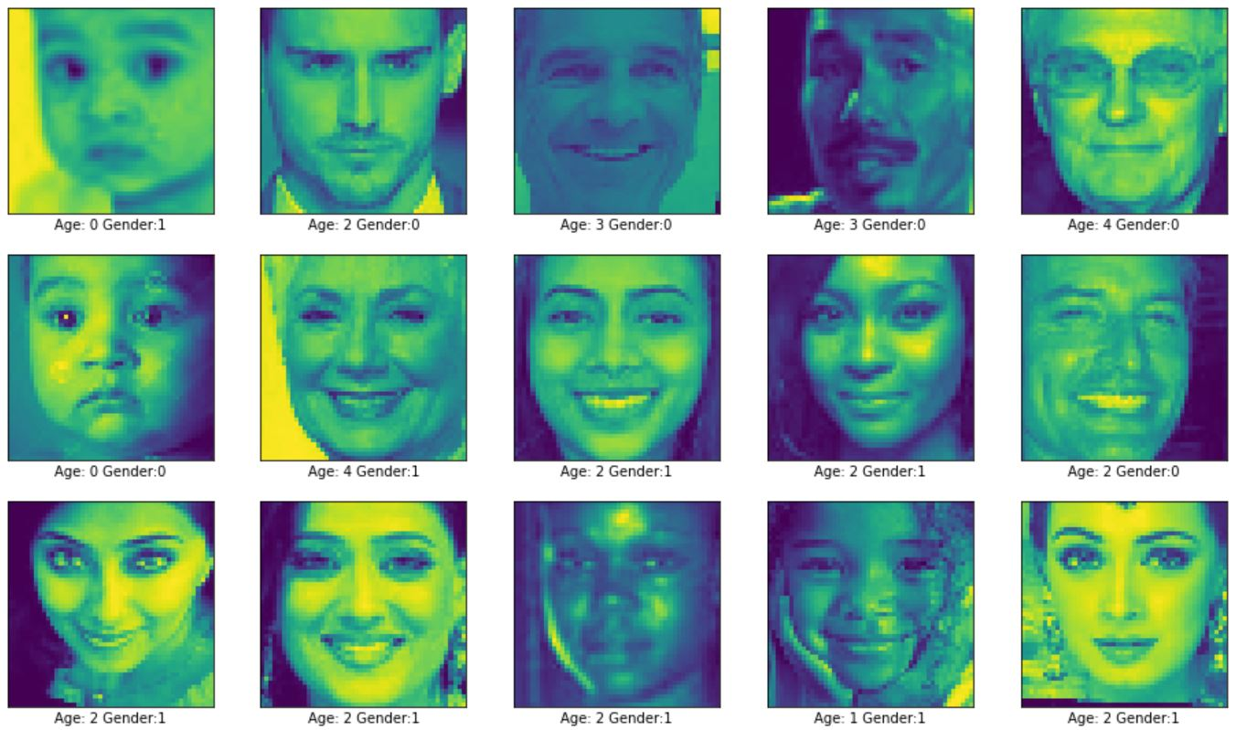
Sample Display after Feature Engineering
BeanStalk

Slide 10
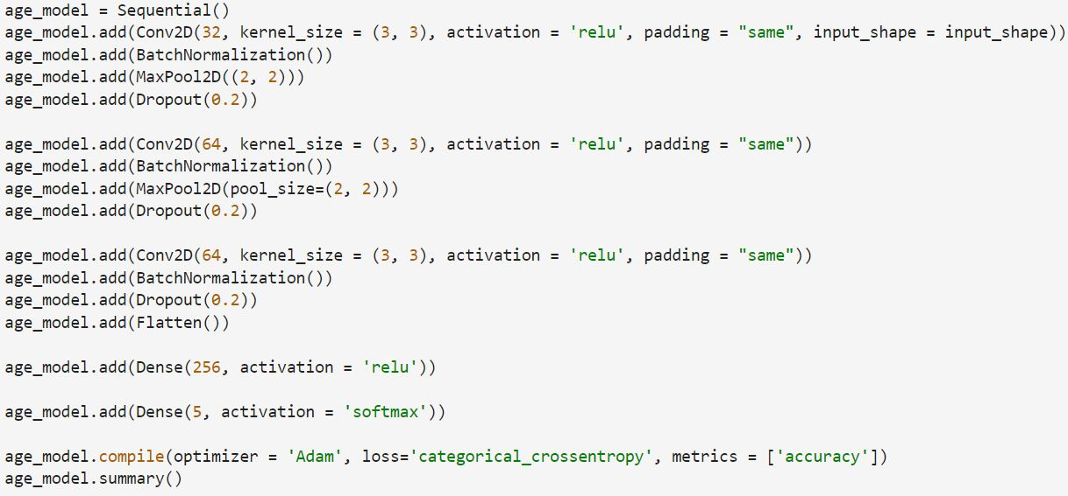
Modelling and Evaluation
Convolutional Neural network (CNN) Model - Age
BeanStalk

Slide 11
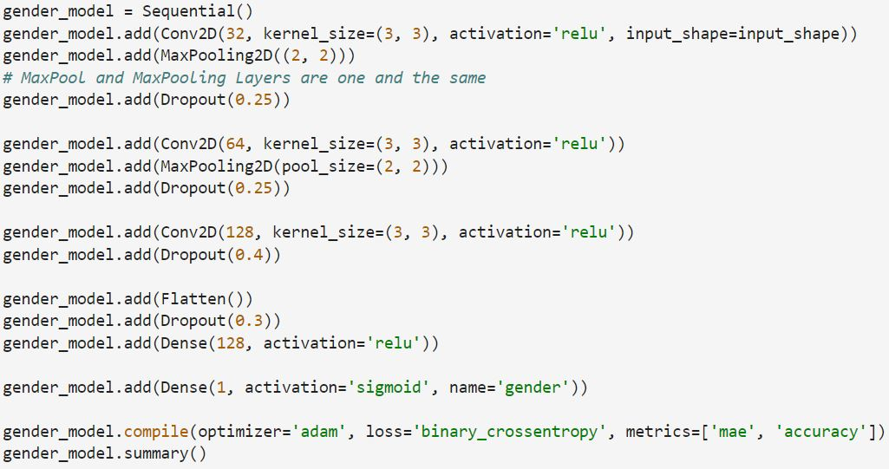
Modelling and Evaluation
Convolutional Neural network (CNN) Model - Gender
BeanStalk

Slide 12
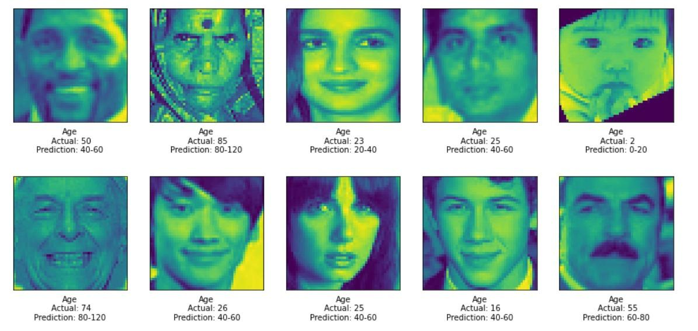

Sample Test Results - Age
BeanStalk

Slide 13
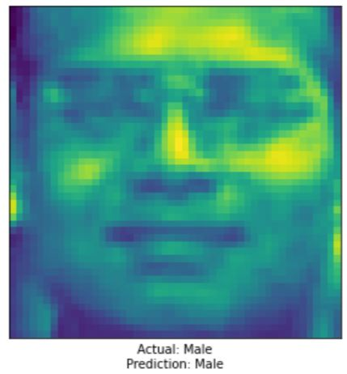
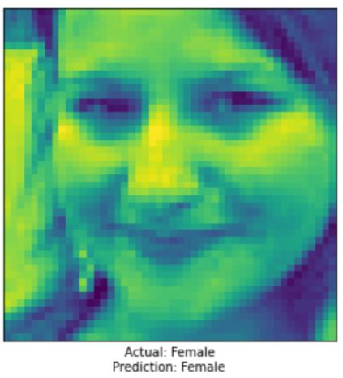
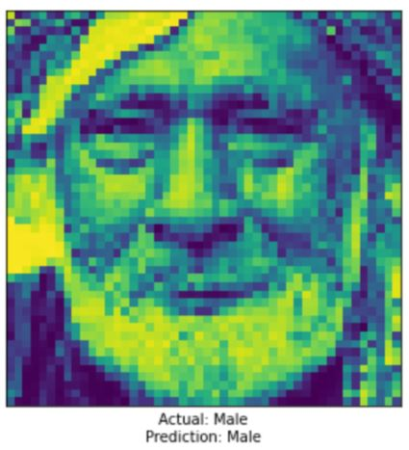
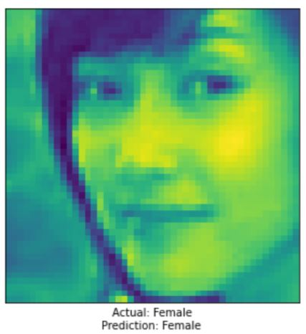
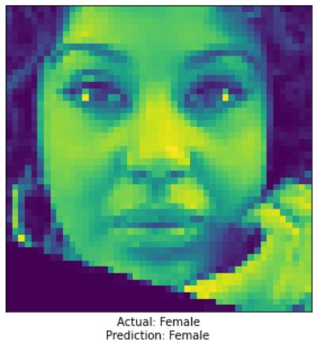
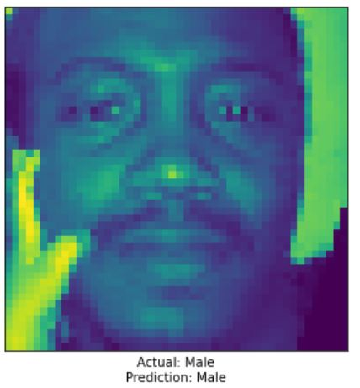
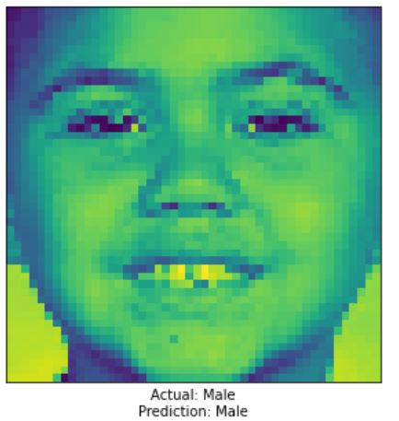
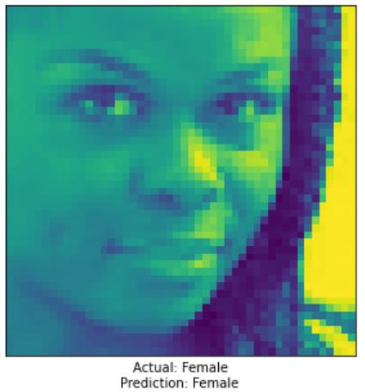
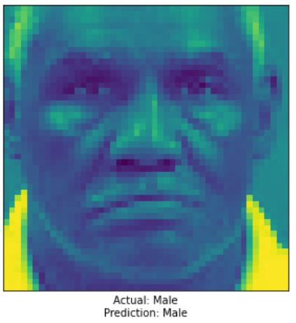
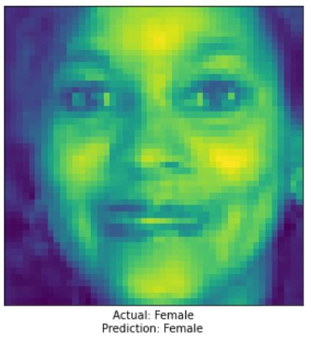
Sample Test Results - Gender
D
BeanStalk

Slide 14
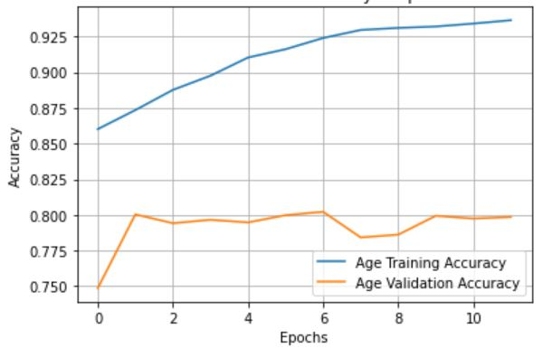
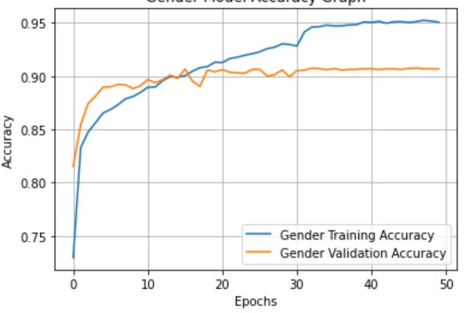
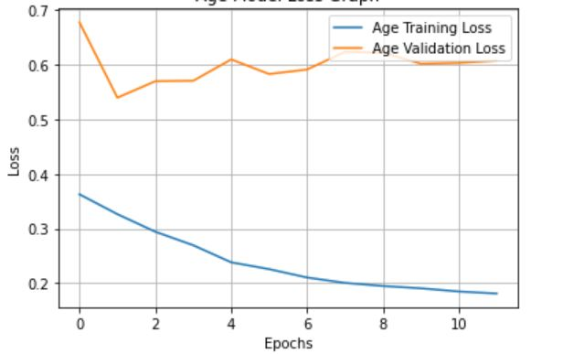
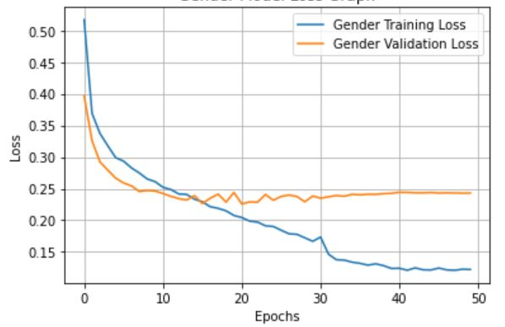
Modelling and Evaluation
Age Accuracy Model
Gender Accuracy Model
Age Accuracy Model
Age Loss Model
Gender Loss Model
BeanStalk

Slide 15
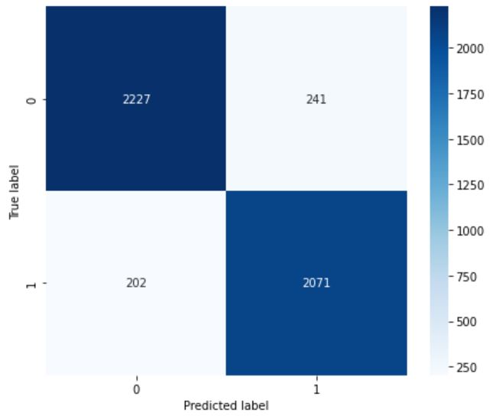
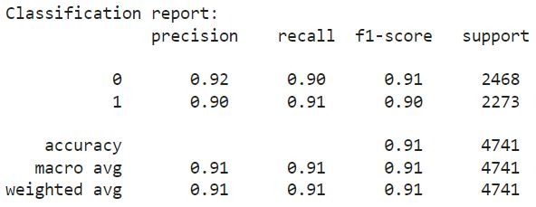
Confusion Matrix and Classification Report
BeanStalk

Slide 16
CONCLUSION
The performance of the CNN model on the UTKFace dataset shows that this innovative architecture is efficient for age and gender detection tasks and could be deployed to other real life use cases such as crime detection, biometrics validation, job interviews, facial recognition or identification of victims and much more.
BeanStalk

